Slide 1
Lane Detection using computer vision for self driving cars
Team no: B009
Team Members: Samudrala Abhiram Rao (18UK1A05A8)
Kasam Sai Shivani (18UK1A0579)
Kandugula Pranith Reddy (18UK1A0597)
Mohammed Saniya (18UK1A0588)

Slide 2
INDEX
Introduction
Objective
Project Flow
Architecture
Implementation
Final result

Slide 3
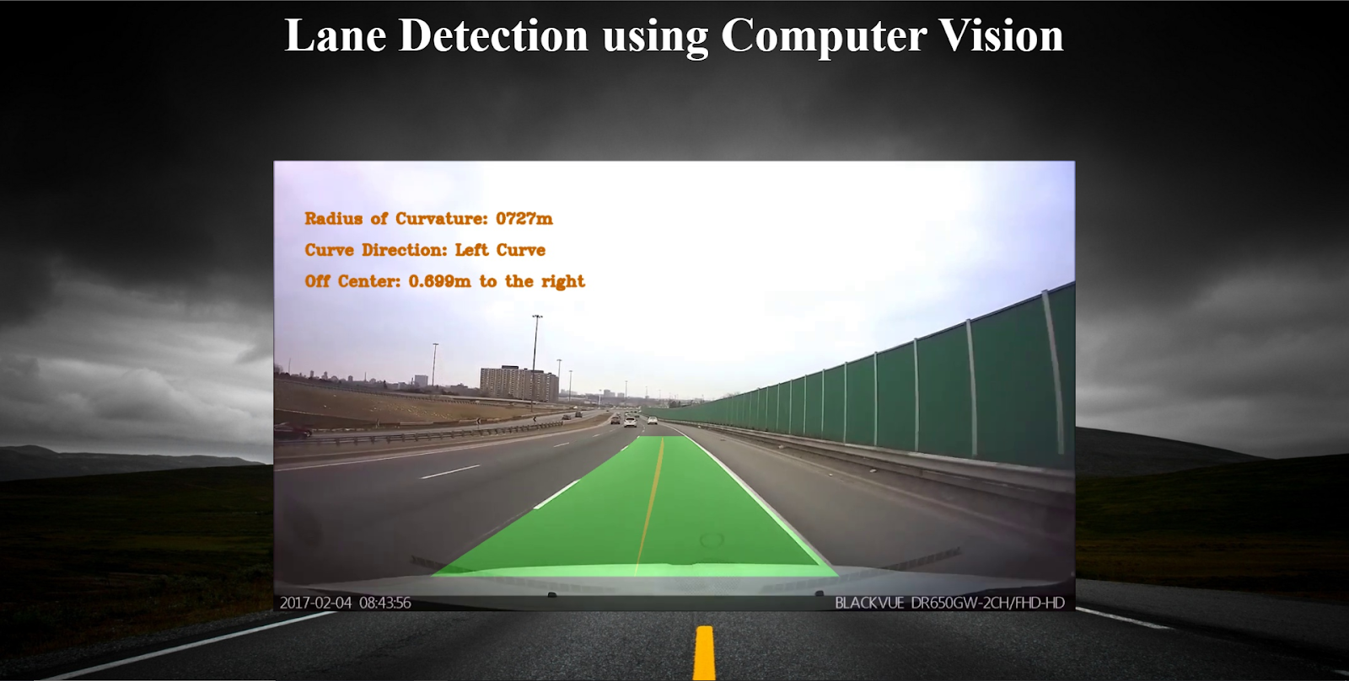
Introduction
Identifying lanes on the road is a common task performed by all human drivers to ensure their vehicles are within lane constraints when driving, so as to make sure traffic is smooth and minimise chances of collisions with other cars in nearby lanes. Similarly, it is a critical task for an autonomous vehicle to perform. It turns out that recognizing lane markings on roads is possible using well known computer vision techniques. We will cover how to use various techniques to identify and draw the inside of a lane, compute lane curvature, and even estimate the vehicle’s position relative to the center of the lane.

Slide 4
Objective
Will be able to build a flask application with a camera that detects lanes on a road.
Will be able to Use Computer Vision functions and operations to a great extent.
Will be able to know how to build and integrate a web application using the Flask framework.

Slide 5
Project Flow
This is the flow of the project
Capturing and decoding video file frame by frame
Conversion of the Image to Grayscale for accuracy and speed
Applying filters to reduce noise in video frames
Edge Detection Using Canny Edge detection method
Finding the region of interest and working on that part
Detecting lanes using Computer Vision Wrapping Technique.

Slide 6
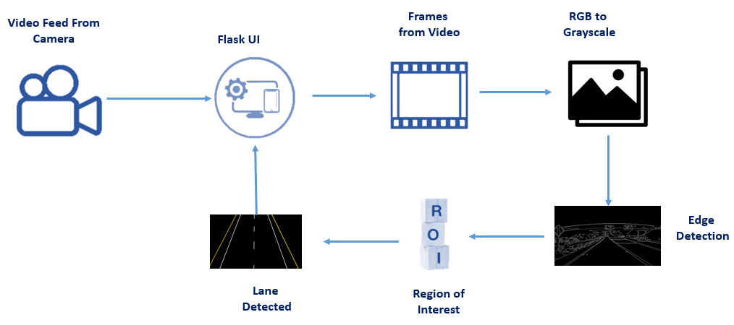
Architecture

Slide 7
Implementation
Processing Of Image
Convert image to grayscale
Threshold of image colors is set up
Perspective Warp Function
matrix: cv2.getPerspectiveTransform ,Matrix to warp the image for Birdseye window
minv : cv2.getPerspectiveTransform(Inverse matrix to unwarp the image for final window.
Get Bird’s Eye View
Display Birdseye view images
Perspective points to be warped and Window to be shown

Slide 8
Implementation
Slide Window Search
we Store all the Data into Stack, With the values obtained with the help of bird's Eye view and Histogram.
Measure Lane Curvature And Off Center
start measuring lane details like curvature, indices, off center values and more. To make the prediction accurate.
Draw Lane Lines And Add Text
Draw Lane Lines and Drawing info of left, right, left_fit, right_fit and ploty function.
Add Text to show and Add the radius and center position to the image.

Slide 9
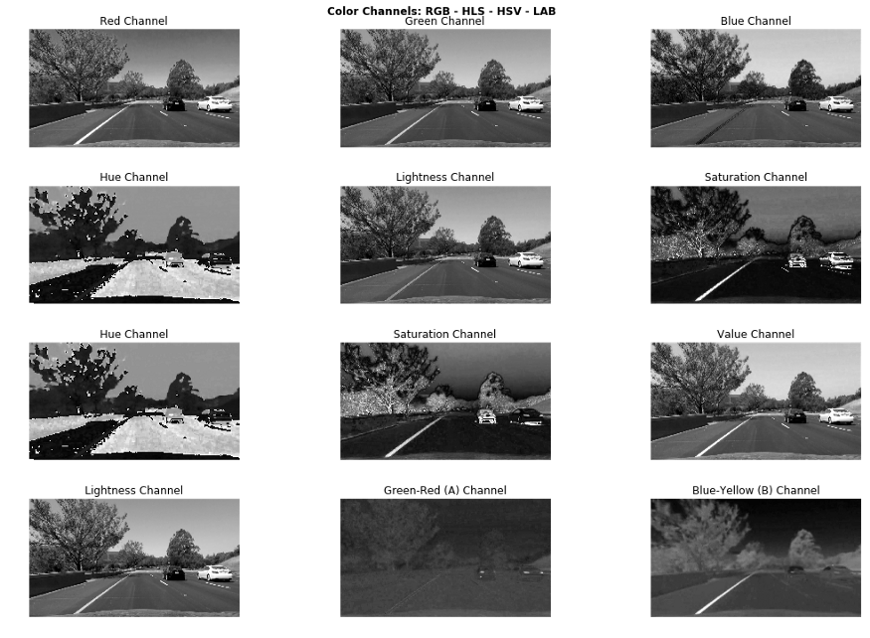

Slide 10
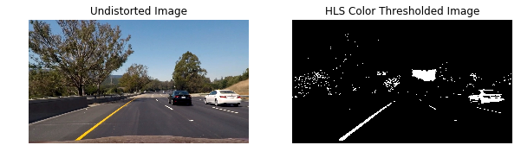

Slide 11
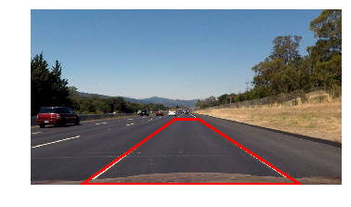
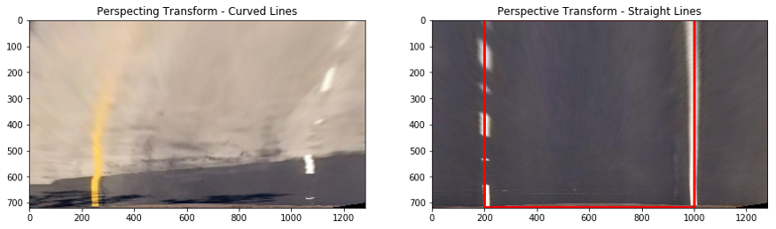
Perspective Transform
Birds Eye view

Slide 12
Final Result

Slide 13
Thankyou

